Slide 1
STUDENT EXPECTATIONS VERSUS SATISFACTIONS FOR 5th YEAR ORAL BLOCK ROTATION
MAIPELO RAKGONGWANYANA

Slide 2
INTRODUCTION
There was generally limited practical skills among 5th year class of 2018 during oral surgery block rotation and there were still students who did not manage to fulfil all practical requirements by the end oral surgery block rotation. So the purpose of this audit is to find the reasons behind the above points.

Slide 3
METHOD
Interview
Questionnaire
Observation

Slide 4
Sample questions to 5th year class of 2018
Are you fluent in Czech ?if not how is your czech in a scale of 1-10?
Did you fulfil your all practical skills? If not,how many percent did you fulfil?
How many extractions do you have? On what period did you manage to do them?
Were you extracting atleast 1 tooth everyday at the outpatient ?
How many nerve blocks do you have? On what period did you manage to do them ?
Were you doing atleast 1 block everyday at the outpatient department?
How many admissions paper do you have ?
Did you ever suture on the real patient?
Have you ever produced an X-ray not just inteprete it?
Do you prefer to work with certain Doctors? Why?
Did you feel useful all the time at outpatient,wards and theatres?
As compared to the previous years, is there any improvement?

Slide 5
Interview
Two random graduates,class of 2017 were interviewed about their experience on oral surgery block.Same questions as for class 2018 were used but this time around using oral interview.

Slide 6
Observation
For a period of 3 weeks students were observed.Observation was done on if students are engaged with some procedures during practicals or just free,if there was balance between and teachers at the outpatients,if there were enough patients for students.

Slide 7
RESULTS
Out of 9 students of class of 2018,3 students were completely fulfilled the required practical skills,1 student was nearly finished with the practical requirements and 5 students were far behind completing practical requirements.Out of 6 who did not fulfil the requirements,3 students highlighted language barrier as one of the reason they did not manage to fulfil the requirements,all 6 students complained of lack of patients and 3 students admitted that there were several times they were hesitant to perform mandibular blocks and molars extraction due to lack of skills.
5 out of 9 students admitted that they prefer to work certain Doctors,their reasons behind this preference were that they felt that some of the Doctors were not willing to help students and some students were scared to work with some Doctors hence were not able to work freely.
All 9 students only interpreted x-rays not producing them, only 5 students sutured on the real patients and all students felt not useful in wards after 10.00am because there was nothing left to do.
There was big margin between students who fulfilled their practicals versus who did not manage,3 students had over 40 extractions while 3 students had 12 extractions.For those who had more extractions confirmed that they acquired to accumulate their extractions when they volunteered during night shifts, weekends ,and during summer holidays.

Slide 9
Comparison of the organisation of oral surgery block between class of 2017 and 2018
(BOTH YEARS)
*admission patients
(2017 CLASS)
*Random patients
(2018 CLASS)
*Own rooms-specific patients
*students seminars
*Presentation of patients in czech
*audits

Slide 10
Strengths and Weakness of organisation of oral surgery block class of 2018
Strengths
Weakness
*early meetings to discuss for inpatients and theatres groups
*Presentation of patients in Czech
*Own rooms-specific patients
*Knowing about operated patients before the getting into the operating room
*No balance of teachers and students
*Finishing very later
*Feeling not useful in wards after check-ups

Slide 11
As compared to Hradec Kralove Dental school instead of 3 week oral block,it is only 1 year clinical block,all specialities combined the whole final year

Slide 12
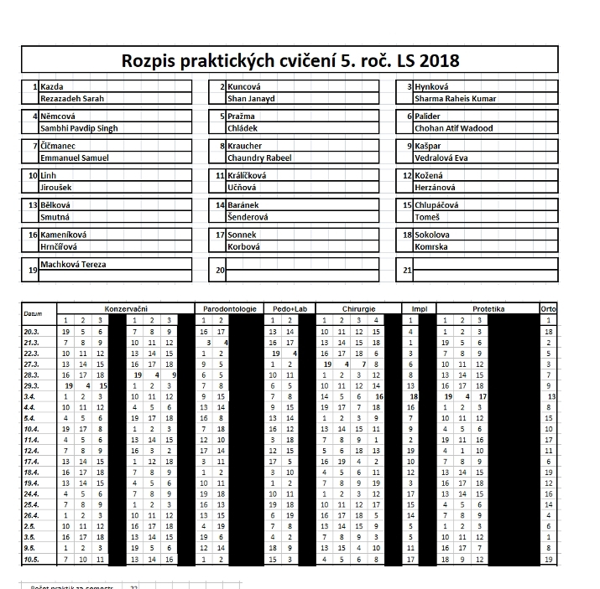
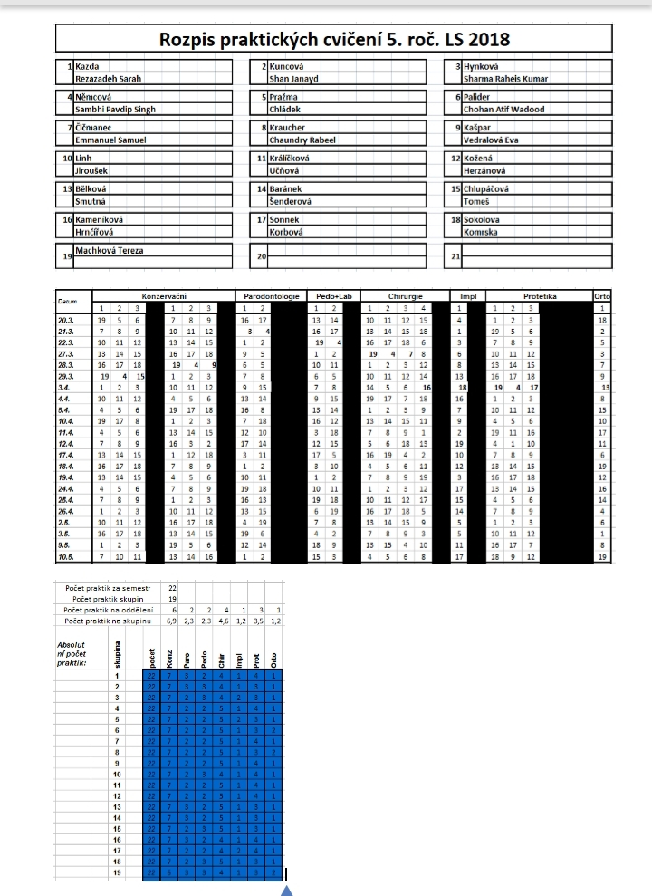
Hradec Kralove dental school 2018 organisation

Slide 13
Pair of students (Czech parallel and English parallel) were randomly placed at different specialties of dentistry,different days of each week.The whole final year students are practicing in all dental specialities (pedostomatology,conservative,prosthodontics,implantology, oral surgery-outpatients,parodontology) instead of blocks.

Slide 14
DISCUSSIONS
As illustrated in fig 1,Czech language is very important and needed to practice and interact with patients as most of patients speak only Czech.Most of students could not speak Czech so they failed to fulfil required practical skills.However the Czech language improved as compared to other years ,presentation patients in Czech could be the reason for such improvement.Since there is always a room for improvement the language barrier can be improved by intercepting Czech and English parallel at the practicals,for instance English and Czech parallel as working partners at the practicals.
As compared to other years there were a lot of improvements such as early meetings,seminars,audits,presentation in Czech,this was quite helpful as students performance positively changed, for instance students at the operating rooms already had the necessary information about the patients.
As compared to Hradec Kralove Dental School which instead of 3 weeks block,it is 1 year block of all clinicals from all specialities of dentistry,which is better as students are able to intercept surgery and other specialities not to create a huge gap where students will be good on one speciality than others.

Slide 15
CONCLUSION
Despite few weakness mentioned above,there is great performance after improvement which were done on 2017.But it would be better if these improvements are implemented from 3rd year not only on final years.
After completion of the block can you confidently work independently; “Knowledge is of no value unless you put it into practice”

Slide 16
DEKUJEME!

