Slide 1
LF1 MEDSOC
2018
Notes:
Name
Logo= Pelican is centrepiece of our facs logo but another reason for encorporating it is the meanig= pelicans have altruistic behavious (selflesness)
Purpose= alma mater hence to develop personality/cahracter/skills/communication and promote equality and achieve academic success
1

Slide 2
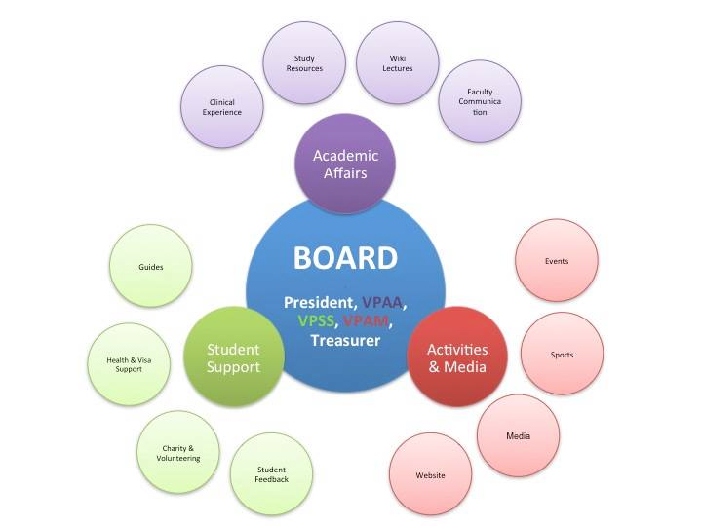
INFRASTRUCTURE
Notes:
So lets start with a small introduction ☺ B: Medsoc is a non-profit student organization founded in 2008.
P: The board: 5 members. President, Treasurer
,VPAA, VPSS, VPAM, These branches have their teams own organization and responsibilities ALL the branches cooperate in order to bring the student body together. In total we have 60 active participants
2

Slide 3
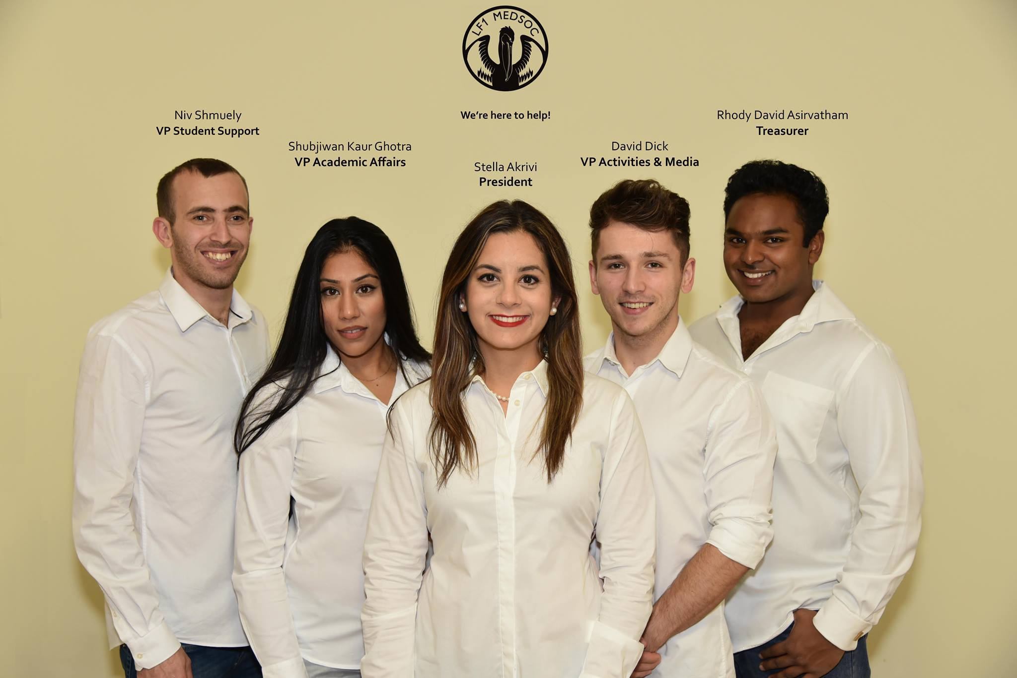

Slide 4
Studentská podpora
Týden nováčků
Zápis a veletrh nováčků
Společenské akce: seznamovací večírek, večeře, bowling, laserová hra,
Uvítací večírek
Buddy System
3-4 tútoři pro každou studijní skupinu
Pravidelné setkání
Pro studenty
Poradenství a pomoc při vízech, hledání bytů atd.
Semináře
kredity a zkoušky
Notes:
We want to give you an idea of how Medsoc is involved in a typical school year.
Suhib: Freshers’ Week
To make sure that every student is properly settled in Prague : We have a formal affiliation with For Students, which is an organization specializes in assisting international students with matters like visas and appartments. Stella: To prepare students in an optimal way we use the Guide system. : students from upper years
this has proved to be very efficient. Freshers feel more secure knowing that the can directly ask questions about university and get advises on how to plan their study time. Especially when it comes from someone who was in their shoes a couple of years ago.
they meet their guides regularly.
Other than that MEDSOC organizes regularly informative seminars regarding the credit system and exam to make sure that everyone is familiar with the university rules. We cooperate with professors and with the students office to make sure that our information is up to date.
4

Slide 5
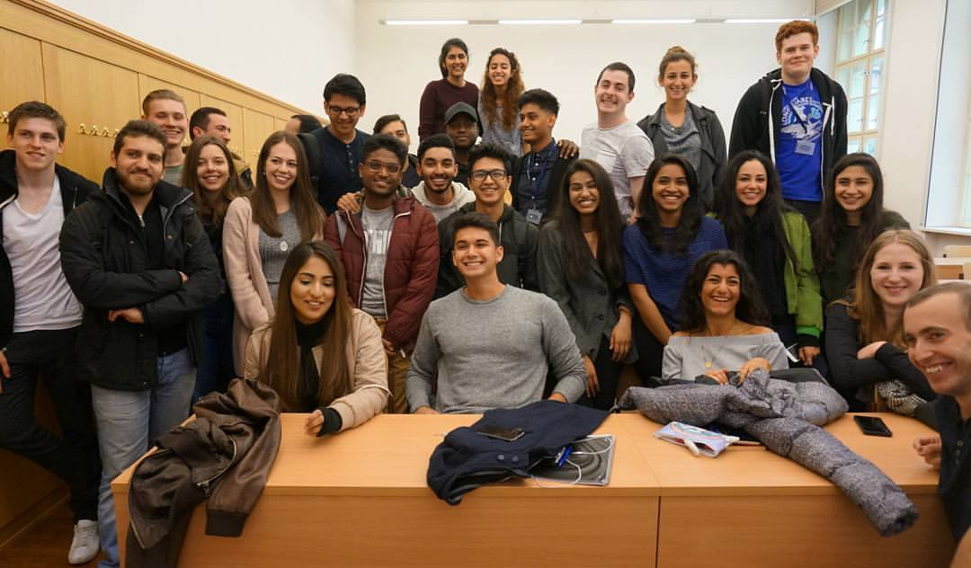
Notes:
Here is a picture from this years Enrollment Day. It’s a great example of how we fully cooperate with the universities in important events. Prof.kittnar kristyna and jitka and a line of guides who are basically students volunteering in our small international society
5

Slide 6
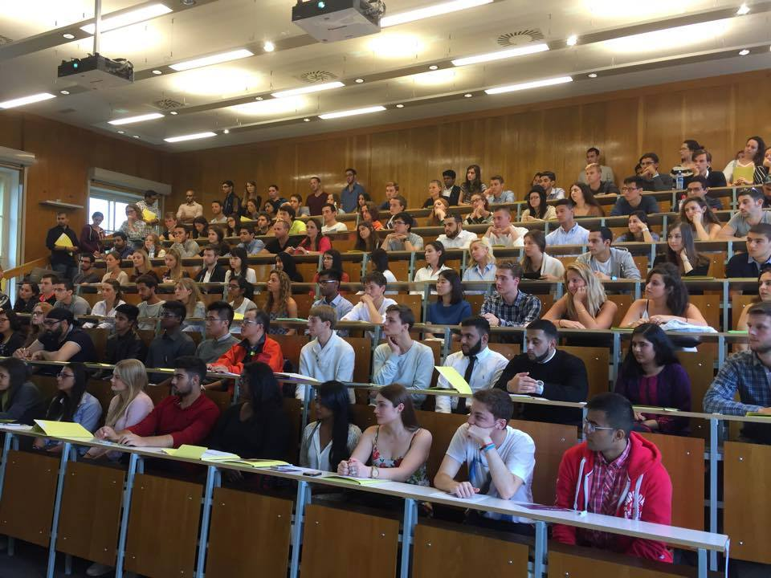
Notes:
Here is a picture from this years Enrollment Day. It’s a great example of how we fully cooperate with the universities in important events. Prof.kittnar kristyna and jitka and a line of guides who are basically students volunteering in our small international society
6

Slide 7
Akademické záležitosti
Prodej knih (více než 1000 knih)
Semináře
Jak získat práci ve Velké Británii / USA / Německo
Workshopy
Šití
ILS (Česká rada pro resuscitaci)
Anatomická disekční seminář
Klinické dovednosti - klinické případy? odběr vzorků krve
Sádrovací workshop (plánujeme
Notes:
Another sector of medsoc , the sector that I am directly involved is the academic affairs. Our First Project in the beginning of the academic year is the book sale. Book sale -interaction of students from upper and lower year -have conversation about the upcoming subjects -buy and sell books in affordable prices in the spirit of academic fraternite. !!!!!!!Booksale attracts students from all faculties. Although LF1 MEDSOC is organizing it,the participation of students from LF2 and LF3 show how popular our event has become.
Moving on to the Dropbox. With the help of my team we have been able to organise study resources and form database for each year. We did so because we believe in equal acessto resources from everyone. Via Dropbox students have equal access to study material, may share presentations and notes for every subject. Our goal is to encourage our students to be as successsful as possible academically. We feel that we support student on lower years enough so we are trying to do something equal for students in upper years. We do so by trying to assist them in
enriching their cv
gaining clinical skills
Informative seminars on how to get a job with the contribution of our allumni network. As medsoc we believe that we should become better and better every year and bring something new to the students. we are oragnizing workshops.
. Currently we are in the process of organizing a suturing workshop sponsored by Johson and Johnson. Last year we organized for the first time the ILS course via the cz resc council in which students showed great interest, so we are planning on making that an annual event.
7

Slide 8
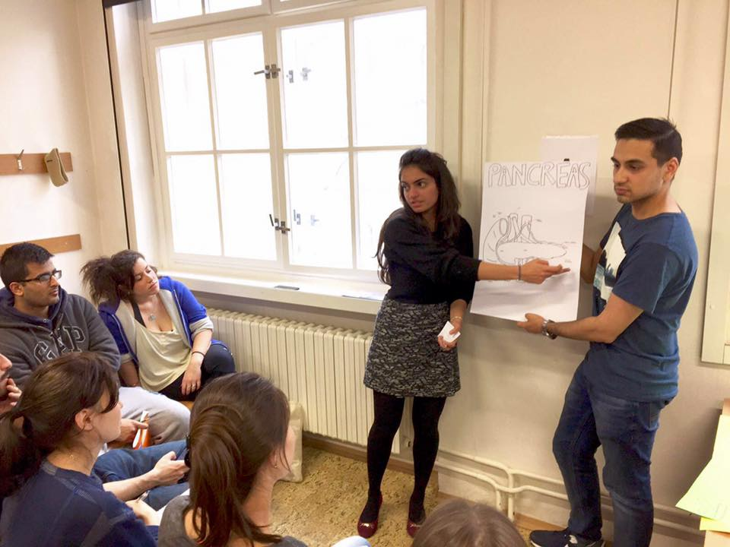
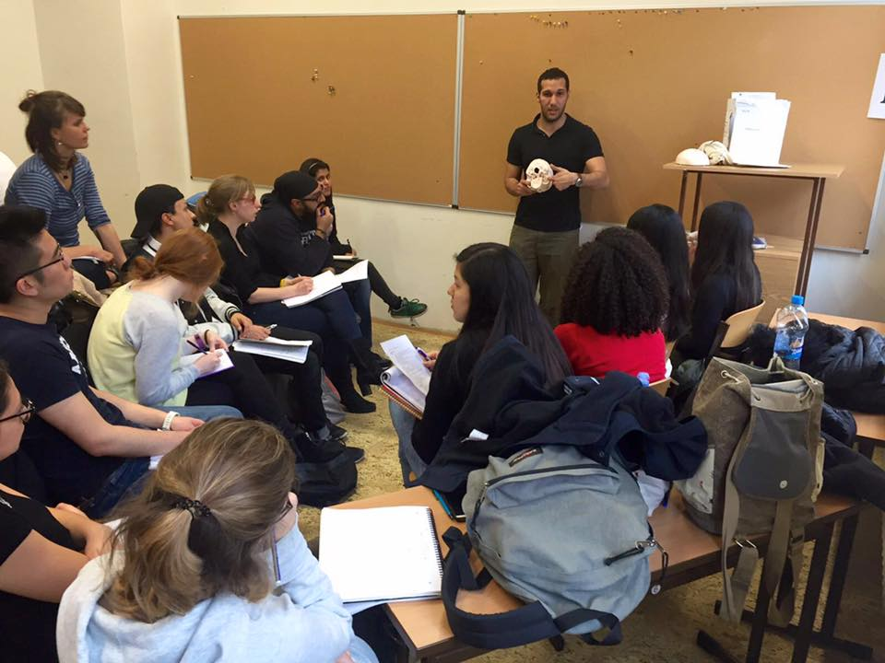
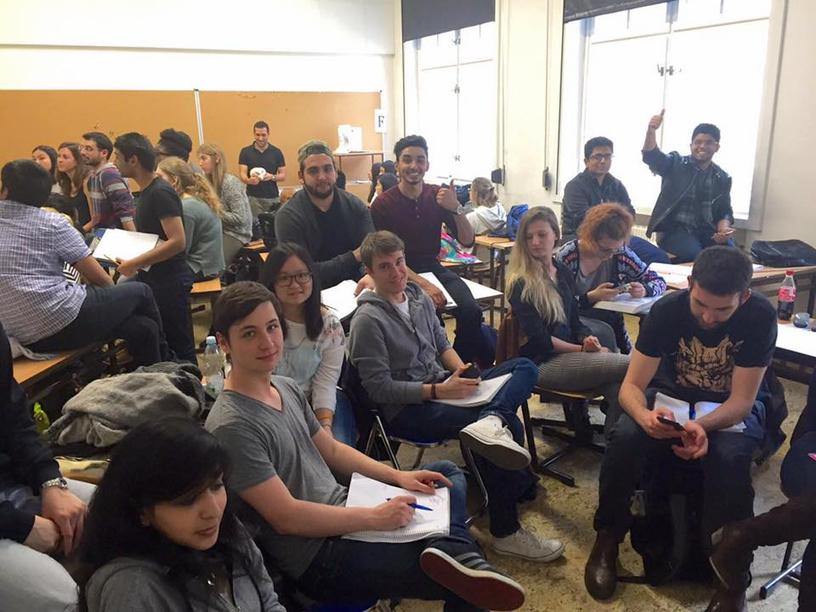

Slide 9
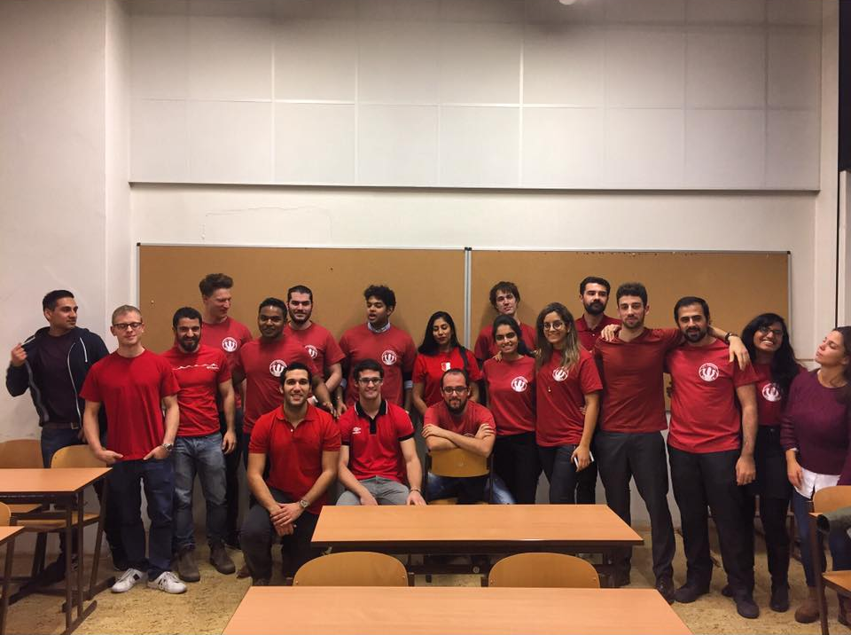

Slide 10
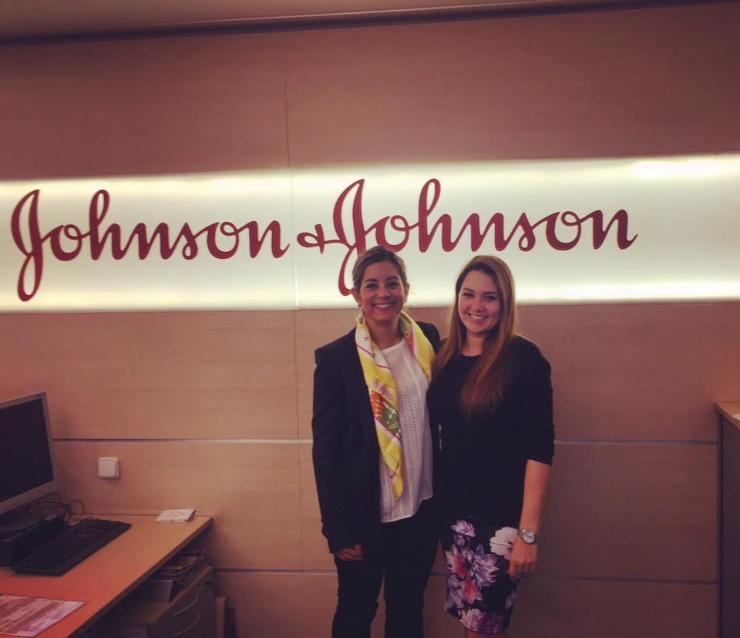

Slide 11
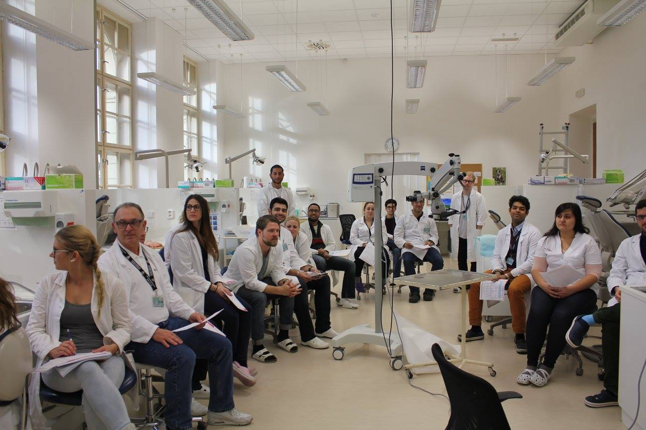
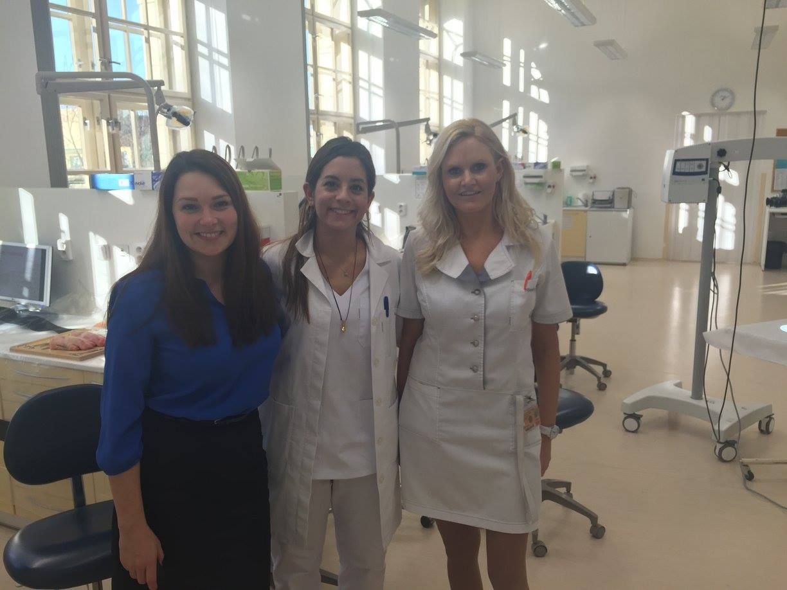

Slide 12
Aktivity a média: Sporty
Kluby: setkávají se každý týden, kdokoli se může připojit
Turistika
Tenis
Volejbal
Běh
Týmy: soutěžní, mezifakultní zápasy
Fotbal (HK, Brno, LF3, Olomouc)
Basketbal (UNYP, HK, Brno, AAU)
Mezifakultní fotbalový turnaj (současní šampióni)
Více soutěžních zápasů, vybavení a školení pro týmy.
Notes:
P: Clubs vs Teams
B: Football Tournament and pics
12

Slide 13
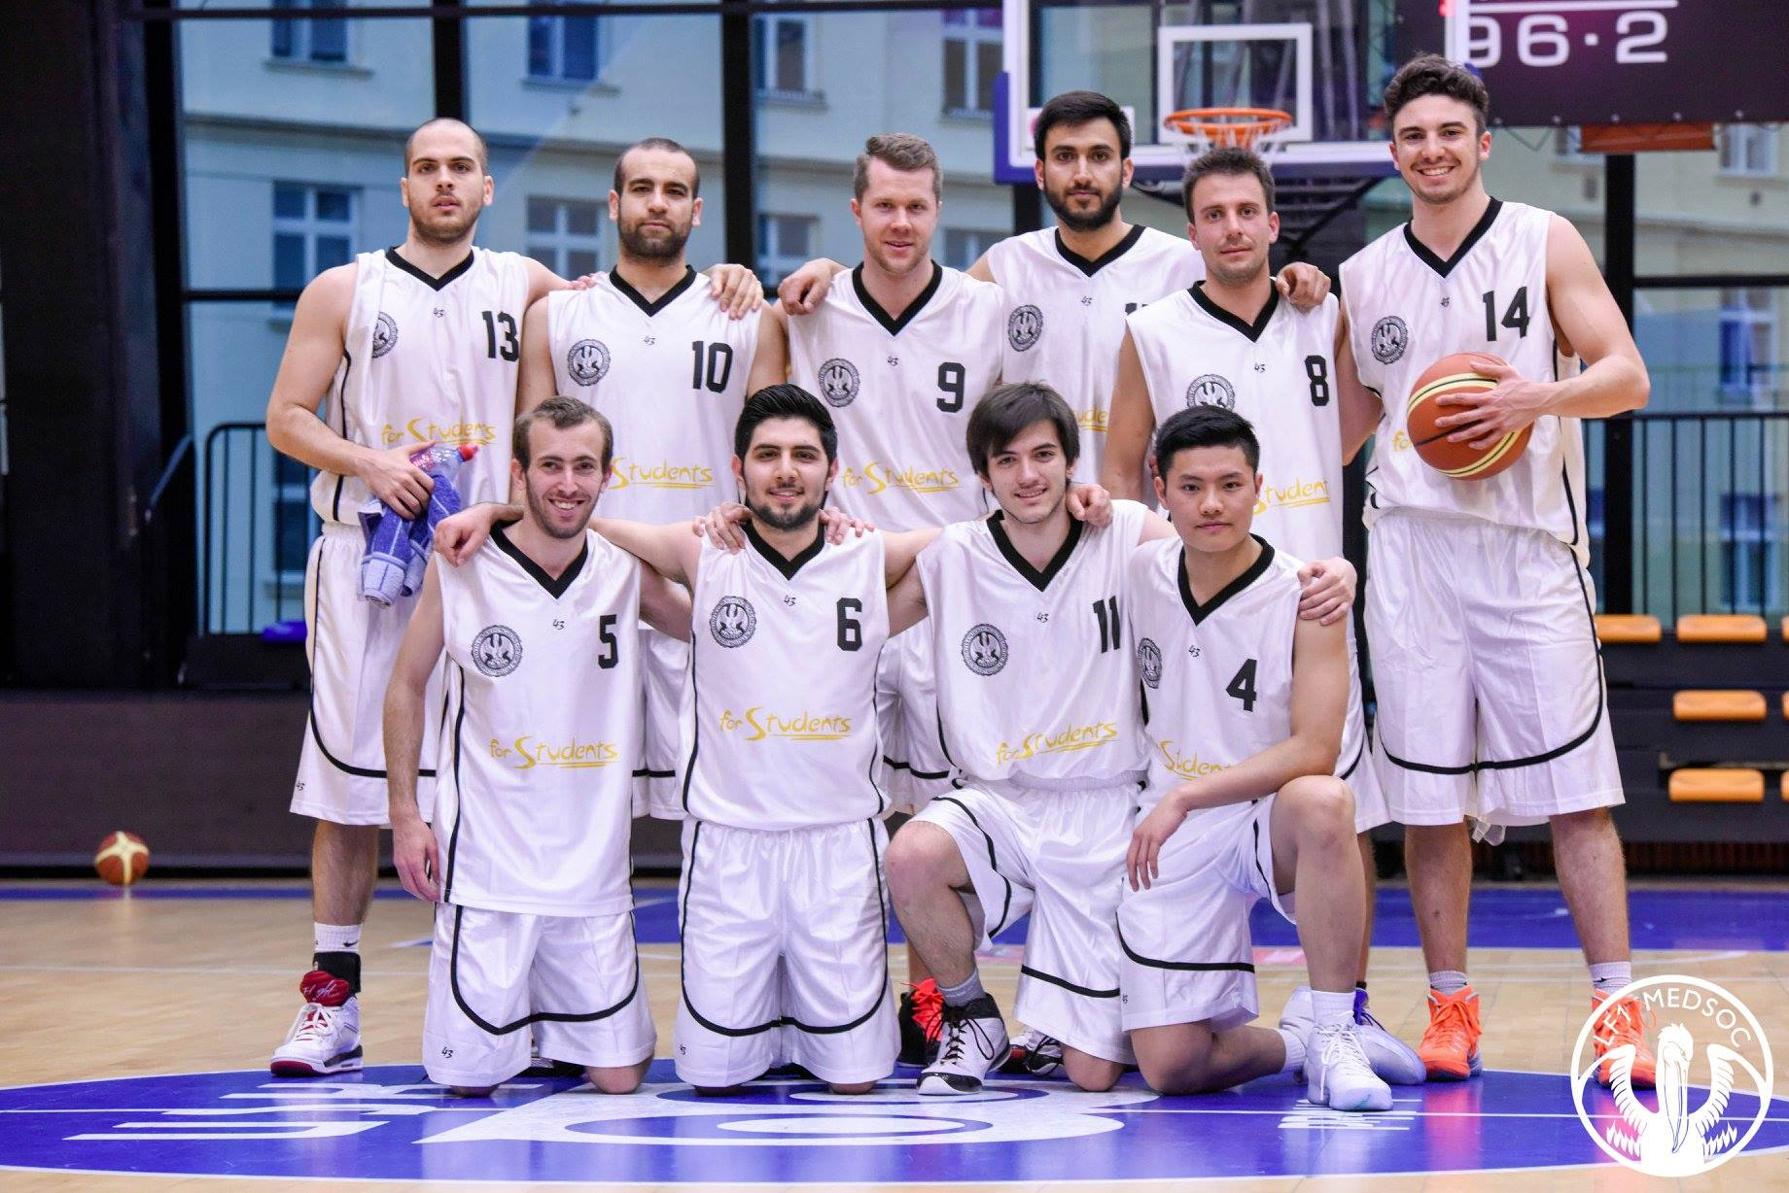

Slide 15
Aktivity a média: Udalost
Jarní ples
Mezifakultní události
Charitativní sbírky
Kluby - turistika, cestování, fotografie, hudba
Notes:
P: Througout the year we have over 20 events from Parties to Sport Events to Charity Fund Raisers.
B: For example we had a fund raiser for Typhoon Haiyan in the Phillipines and this past weekend we had an x-mas party with 2nd faculty English parallel. Last year we had a Christmas intenational food fair which was a great way to integrate the many cultures that are represented at our faculty. Cooperation with SMC.
P: The biggest event of the year is the spring ball which we believe is
annual event of Clothes donation via the Redcross , late next month. Next moth we are also organising a movember party,
Where all profits go to prostate cancer research.
As medical students we see great importance in raising awareness for such issues.
15

Slide 17
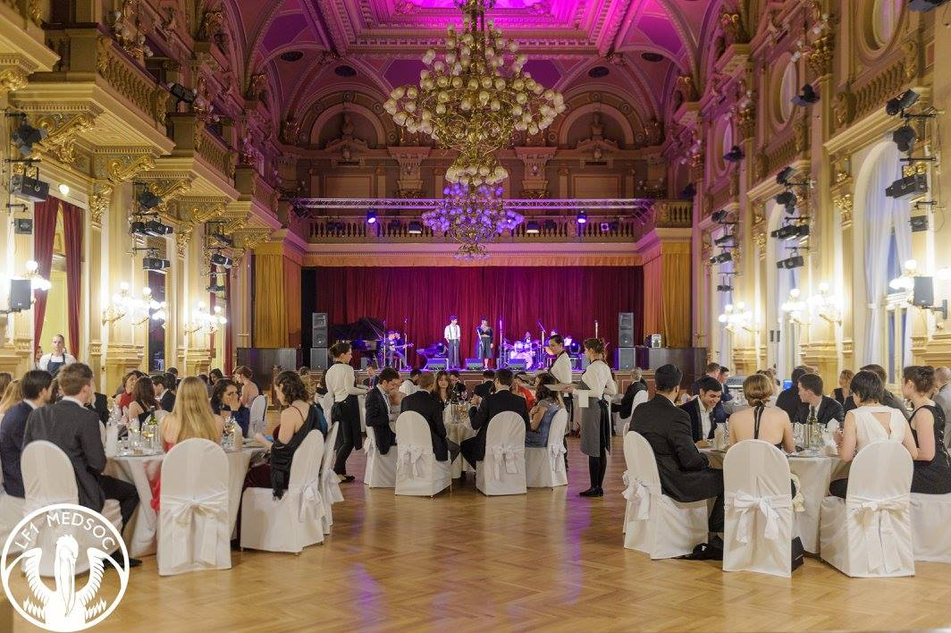
Notes:
Hiking, running, music
17

Slide 18
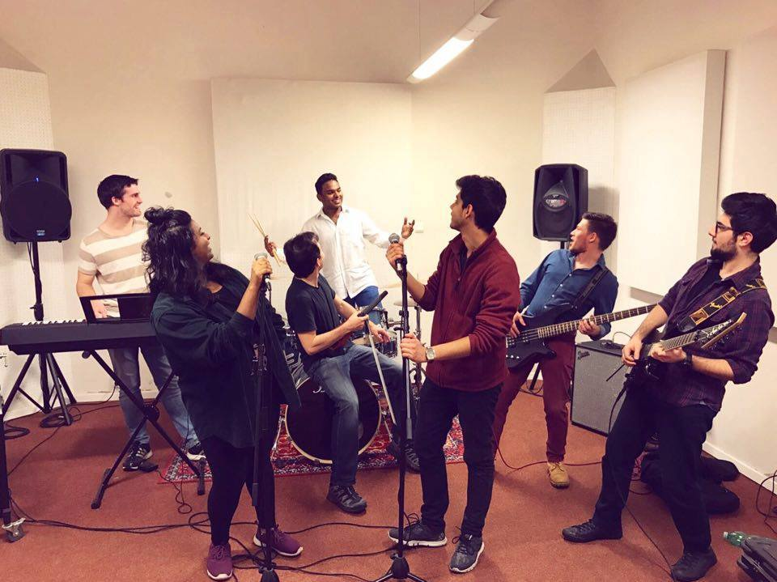
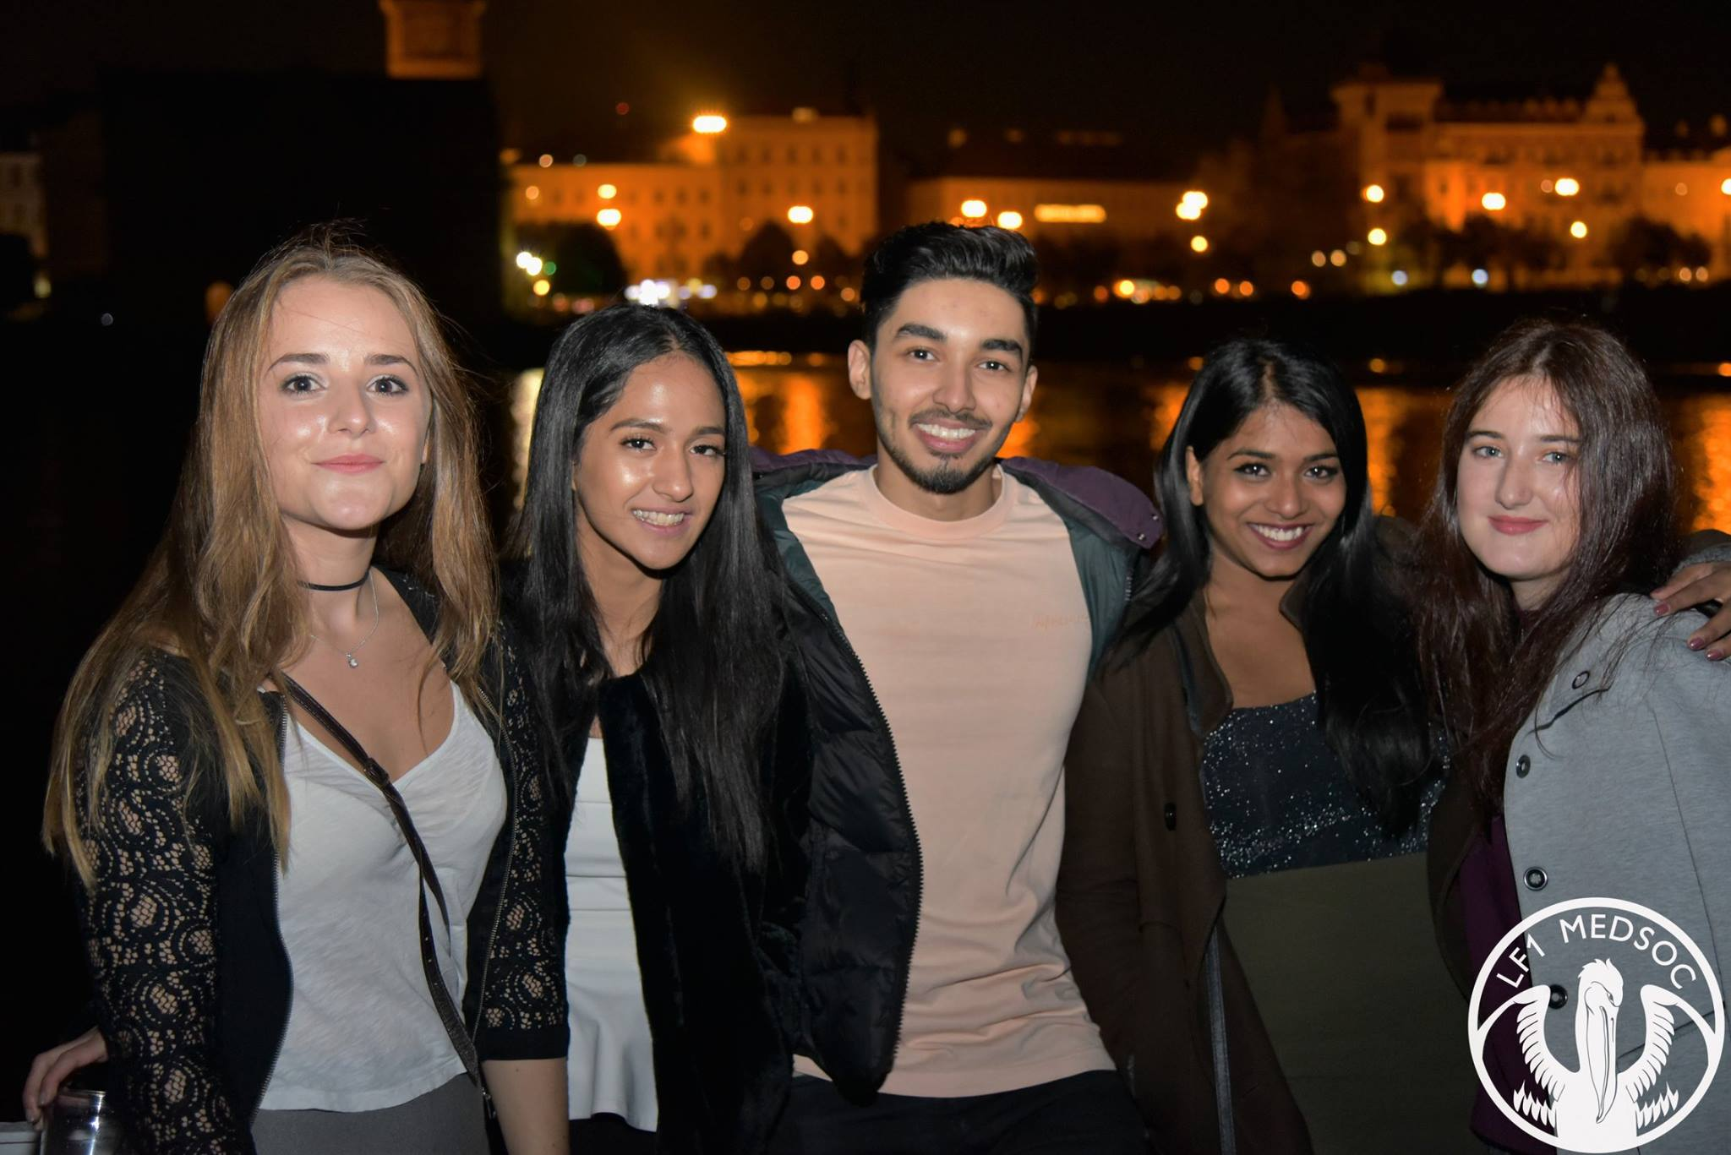

Slide 19
Dobročinnost
Jídlo pro bezdomovce
Večírky se sbírkama - výtěžek směřuje ke specifickým charitám
Návštěvy sirotčinců
Základní lékařská výchova ve školách
Návštěvy útulků pro psy
Notes:
P: Througout the year we have over 20 events from Parties to Sport Events to Charity Fund Raisers.
B: For example we had a fund raiser for Typhoon Haiyan in the Phillipines and this past weekend we had an x-mas party with 2nd faculty English parallel. Last year we had a Christmas intenational food fair which was a great way to integrate the many cultures that are represented at our faculty. Cooperation with SMC.
P: The biggest event of the year is the spring ball which we believe is
annual event of Clothes donation via the Redcross , late next month. Next moth we are also organising a movember party,
Where all profits go to prostate cancer research.
As medical students we see great importance in raising awareness for such issues.
19

Slide 21
Sociální média
Oficiální Facebooková stránka (1800+ se líbí) Https: //www.facebook.com/lf1medsoc/
Oficiální stránka Instagram Https: //www.instagram.com/lf1medsoc/
Oficiální stránky http://www.lf1medsoc.net/
Komunikaci prostřednictvím sociálních médií považujeme za klíčový způsob, jak udržet náš vztah s našimi studenty.
Notes:
We see communication as a key way of maintaining our relationship with our students.
Social media is more important than ever and we strive to be at the forefront at all times
21

Slide 22
Finance
LF1 MEDSOC je nezisková organizace.
Zdroje příjmů: události, financování z univerzity
Naším cílem je učinit naše akce a zboží co nejlevnější a nejpřístupnější studentům.
Notes:
P: I would like to emphasize again that we are a non-profit student organization and all the money we make goes back to the student body. Our main sources of income are from the events in fresher's week and from the generous funding we get from the university. However our goal is to keep all other events as inexpensive as possible so that more students attend. We would like to stress that MEDSOC is an asset to the university and despite the fact that we are a relatively young organization. We have been progressing at a rapid and would like to continue to do so, with your support.
22

Slide 23
DĚKUJI VÁM ZA VÁŠ ČAS

